Slide 1
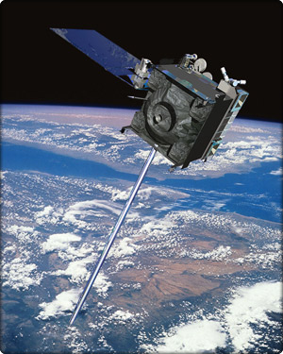
Orbital Motion
DISCLAIMER:
No dogs were harmed in the making of this presentation
The dogs in this presentation are highly trained cartoon “stunt dogs”.
DO NOT TRY THIS AT HOME

Slide 2


How far could you kick a dog?
From a table, medium kick.

Slide 3
How far can you kick a dog?
Gravity

Slide 4
Harder kick?

Slide 5
Harder kick
Gravity

Slide 6
Small cannon?
Woof! (help)

Slide 7
Small cannon
Woof! (help)
Gravity

Slide 8
Bigger cannon?

Slide 9
Bigger cannon
Gravity
Gravity

Slide 10
Even bigger cannon?

Slide 11
Even bigger cannon
Gravity
Gravity
Gravity

Slide 12
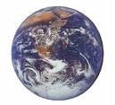
VERY big cannon?

Slide 13
VERY big cannon
Gravity

Slide 14
Humungous cannon?

Slide 15
Dog in orbit!
The dog is now in orbit! (assuming no air resistance of course)

Slide 16
Dog in orbit!
The dog is falling towards the earth, but never gets there!
Weeee!
This is FUN!

Slide 17
Dogs in orbit!
Now .. How do I get back?
The force that keeps an object moving in a circle is called the centripetal force (here provided by gravity)
Gravity

Slide 18
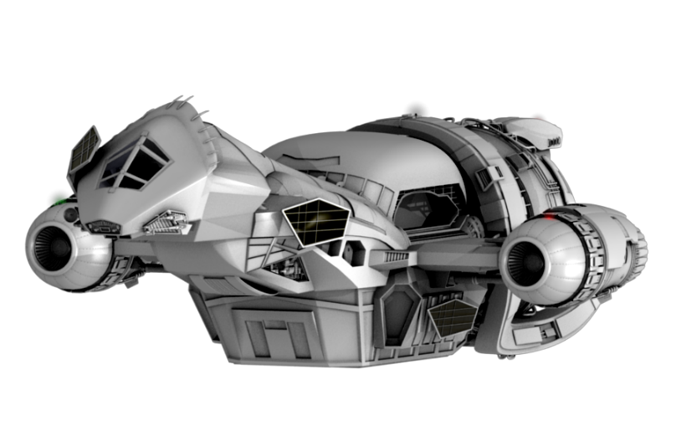
Satellite orbits
In orbit at 350km - gravity is around 9m/s².
Each second the space-craft will move forward around 7700m......
And fall 4.5m 7700m
4.5m
This curve will follow around the Earth at the same height.

Slide 19
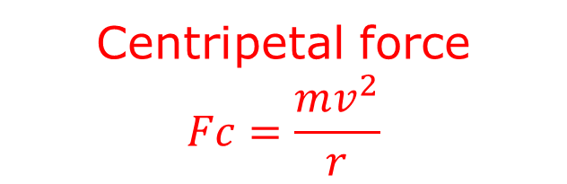
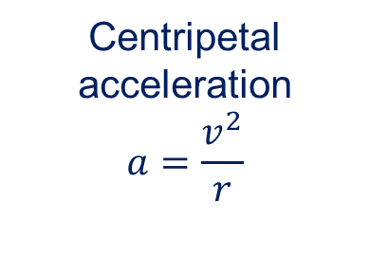
Uniform Circular Motion
Remember we have already looked at circular motion
Centripetal acceleration
$$a=\frac{v^{2}}{r}$$
Centripetal force
$$Fc=\frac{mv^{2}}{r}$$
velocity

Slide 20
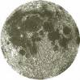
Uniform Circular Motion
For orbital motion, the centripetal force is provided by gravity
Earth’s gravitational attraction on moon

Slide 21
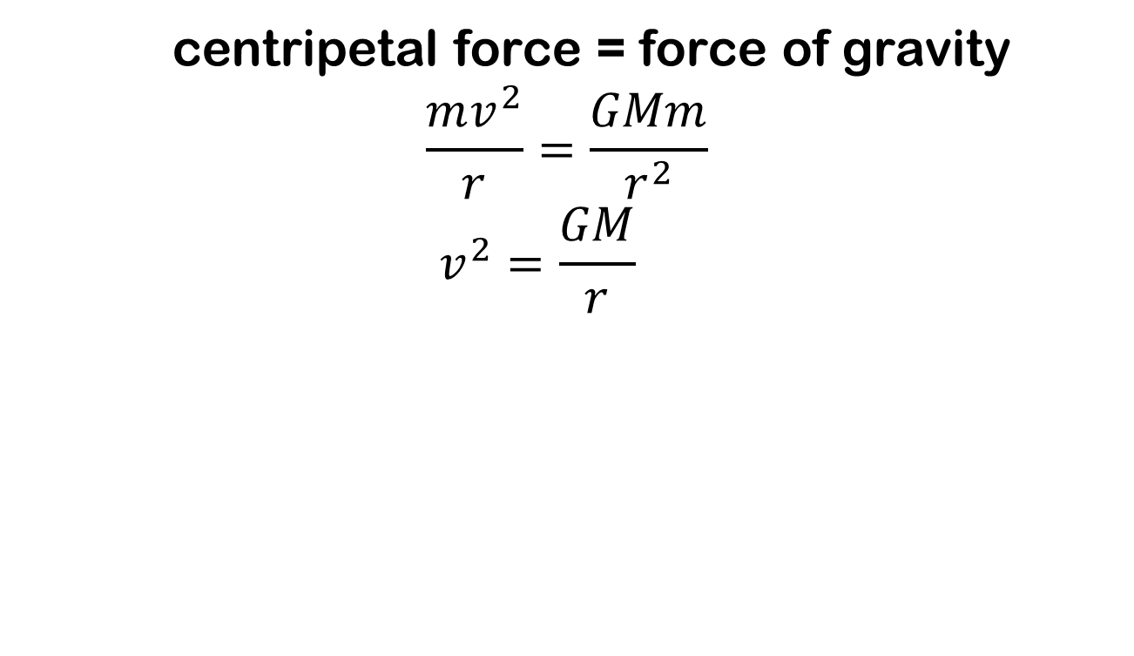
Uniform Circular Motion
centripetal force = force of gravity
$$\frac{mv^{2}}{r}=\frac{GMm}{r^{2}}$$
$$v^{2}=\frac{GM}{r}$$
Earth’s gravitational attraction on moon

Slide 22
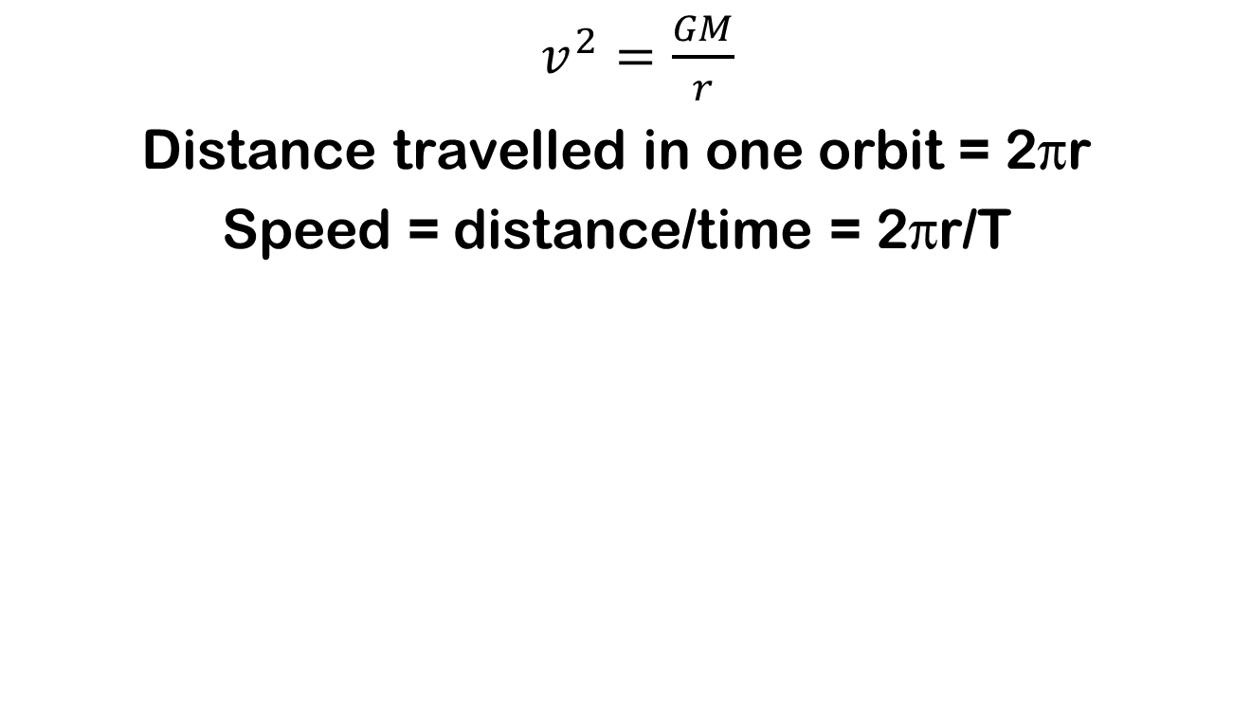
Period of orbit
$v^{2}=\frac{GM}{r}$
Distance travelled in one orbit = 2πr
Speed = distance/time = 2πr/T
Earth’s gravitational attraction on moon
(T = period of orbit)

Slide 23
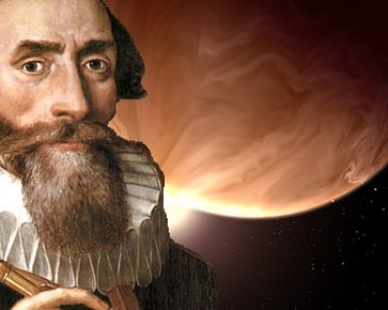
Who was Kepler?
Johannes Kepler was a Dutch astronomer, who assisted the royal astronomer Tycho Brahe.
Brahe was famous for his extremely precise measurements of the positions of the planets over many years.
Upon Brahe’s death, Kepler inherited all of Brahe’s detailed measurement data.

Slide 24
The Shape of Planetary Orbits
Kepler realized that circular orbits could not explain the observed positions of the planets.
He took the measurement data, and searched for a mathematical model that would fit the data.
His results are now called
‘Kepler’s Laws of Planetary Motion.’

Slide 25
Kepler’s First Law
Planets orbit the sun in an ellipse, with the sun located at one focus.

Slide 26
Ellipse?? Focus??
Take a loop of string. Place two thumbtacks on a sheet of paper, then trace around the string.
focus
focus

Slide 27

Kepler’s Second Law
An imaginary line joining the planet and the sun will sweep out equal areas in equal intervals of time.
Translation: Planets move faster when closer to the sun and slower when Further away.

Slide 28
Kepler’s Third Law
The ratio of period squared to orbital radius (average distance to sun) cubed will be the same for all objects orbiting the same body.
T = Period of revolution (time it takes to orbit the sun)
R = orbital Radius (average distance from planet to sun)

Slide 29
Kepler’s Law Example
Galileo discovered four moons orbiting Jupiter. Io, measured at 4.2 units away from Jupiter, has a period of 1.8 days.
Ganymede is located 10.7 units away from Jupiter. What is Ganymede’s period?

Slide 30
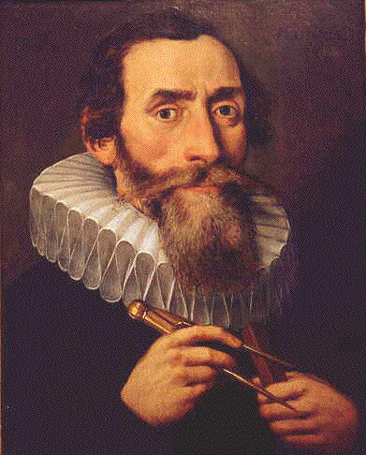
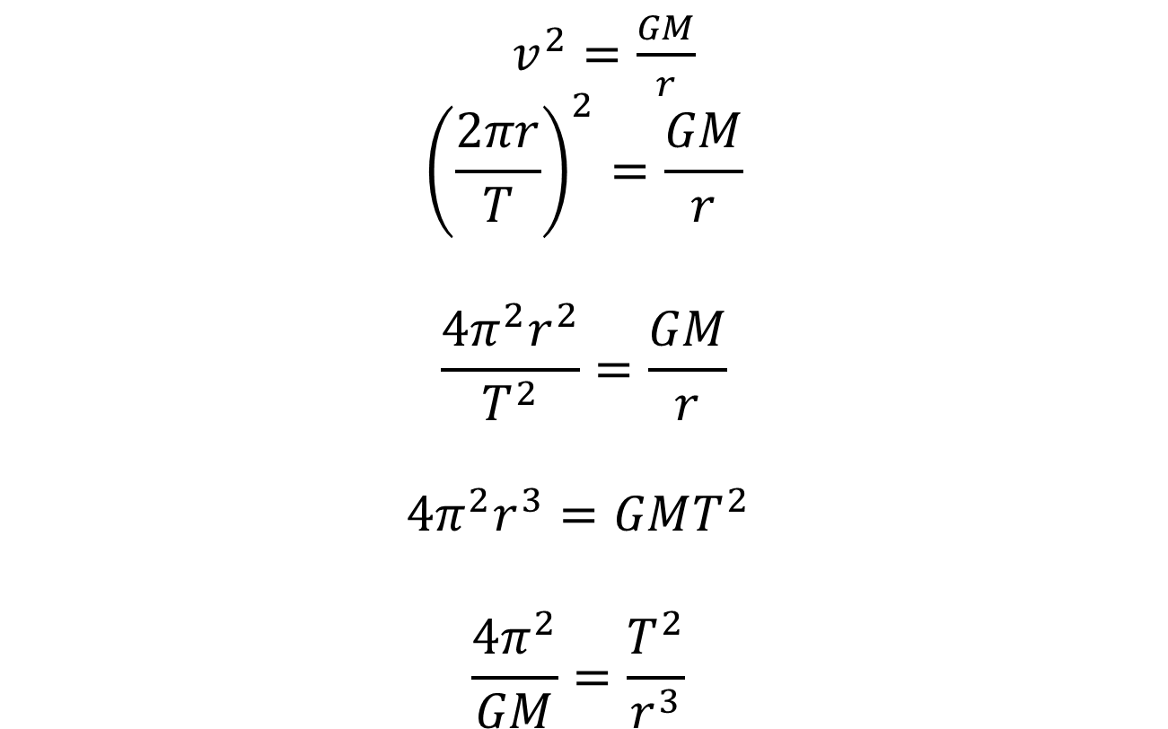
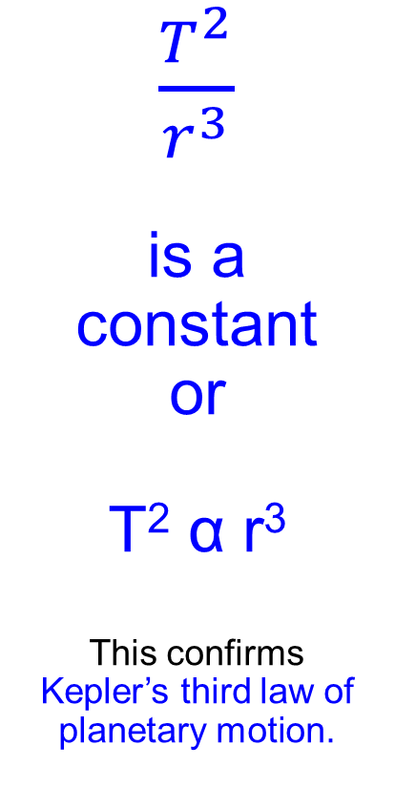
Newtons Law’s vs Kepler
$v^{2}=\frac{GM}{r}$
$${\left(\frac{2πr}{T}\right)}^{2}=\frac{GM}{r}$$
$$\frac{4π^{2}r^{2}}{T^{2}}=\frac{GM}{r}$$
$$4π^{2}r^{3}=GMT^{2}$$
$$\frac{4π^{2}}{GM}=\frac{T^{2}}{r^{3}}$$
$\frac{T^{2}}{r^{3}}$
is a
constant
or
T² α r³
This confirms
Kepler’s third law of planetary motion.

Slide 31
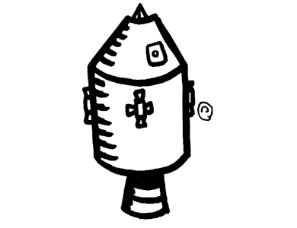

Weightlessness
Consider an astronaut in a space ship orbiting the earth

Slide 32
Weightlessness
Remember both the ship and astronaut are falling towards the earth (centripetal acceleration)
v
mv²/r

Slide 33
Weightlessness
Because they are both falling together, the astronaut feels no reaction force from the floor of the space craft so she feels “weightless” (you get a small feeling of this as a lift (elevator) starts to descend).
acceleration = v²/r

Slide 34
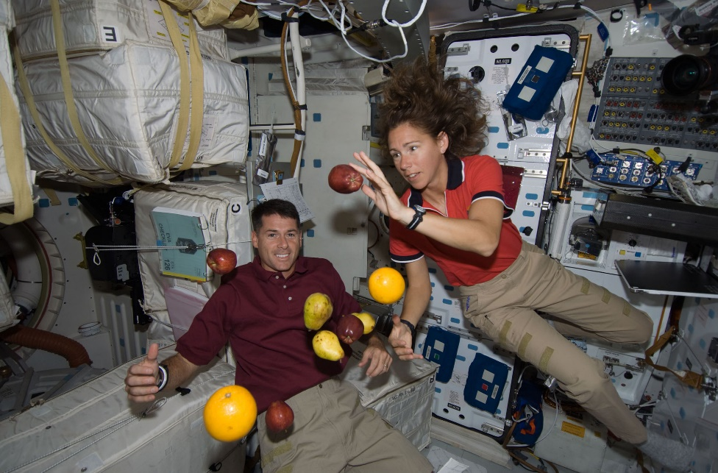
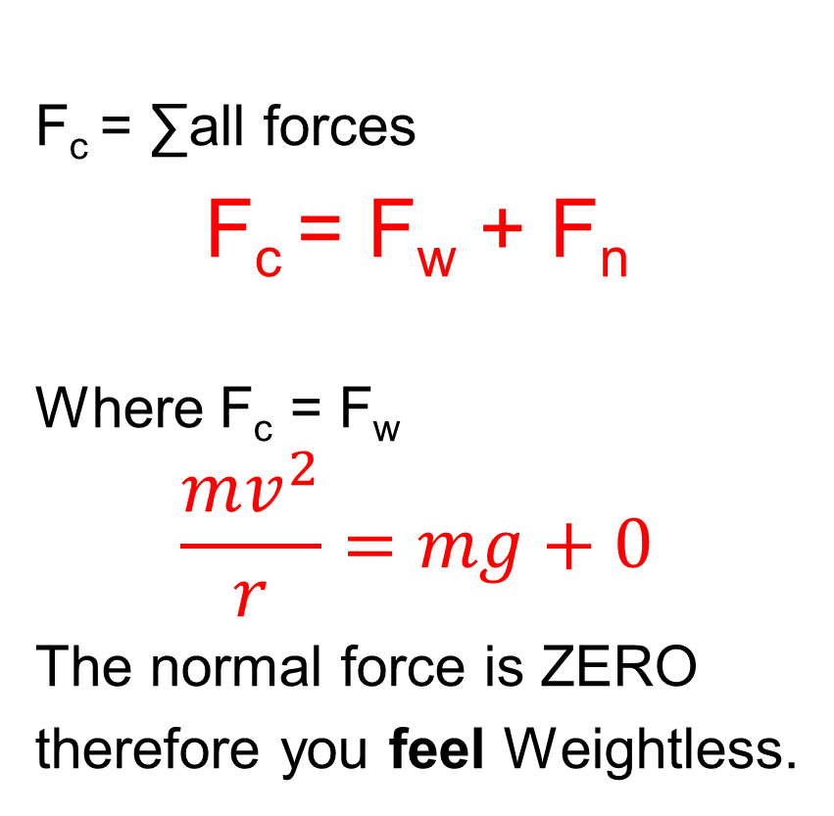
Weightlessness
F_{c} = ∑all forces
F_{c} = F_{w} + F_{n}
Where F_{c} = F_{w}
$$\frac{mv^{2}}{r}=mg+0$$
The normal force is ZERO
therefore you feel Weightless.

Slide 35
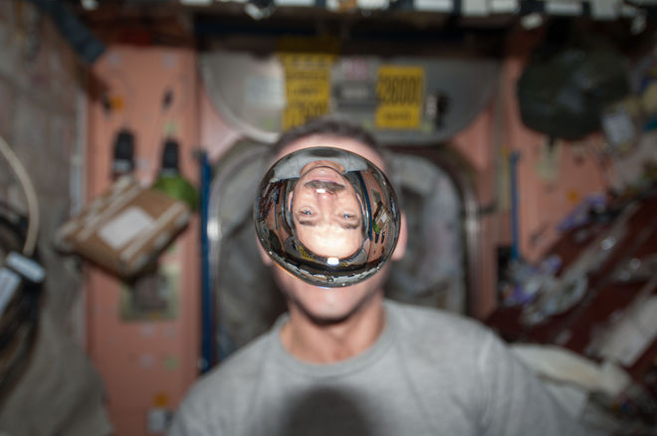
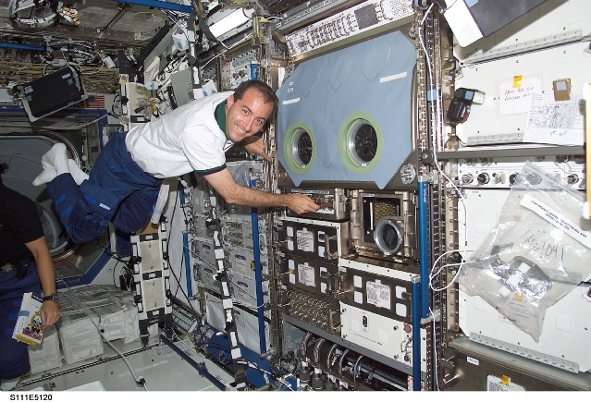
Weightlessness
So there is a force of gravity on the astronauts, but no reaction force from the floor so the astronaut feels weightless.

Slide 36
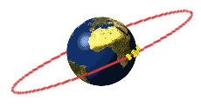
Classifying orbits

Slide 37
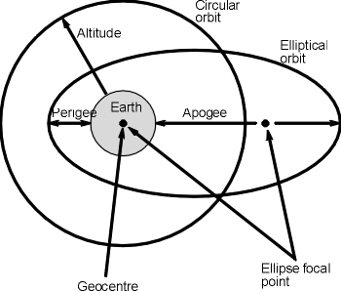
Classifying orbits
Orbits are classified according to three main characteristics:
Inclination (angle to equator)
Altitude
Period
In addition, the shape of an orbit can be vary from circular to elliptical if required.

Slide 38
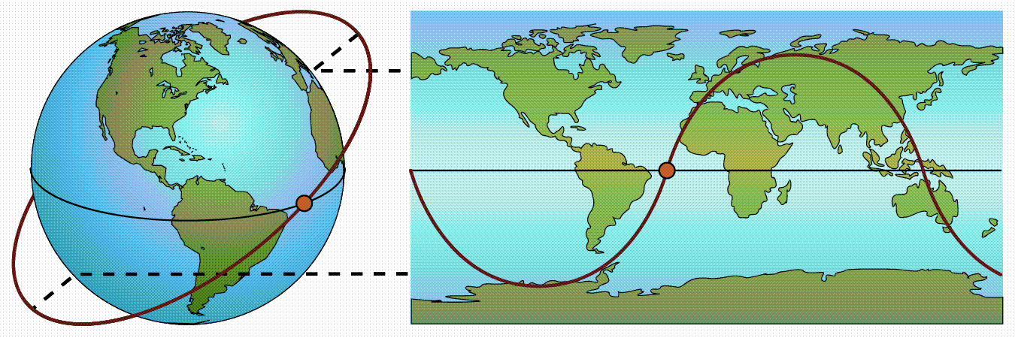
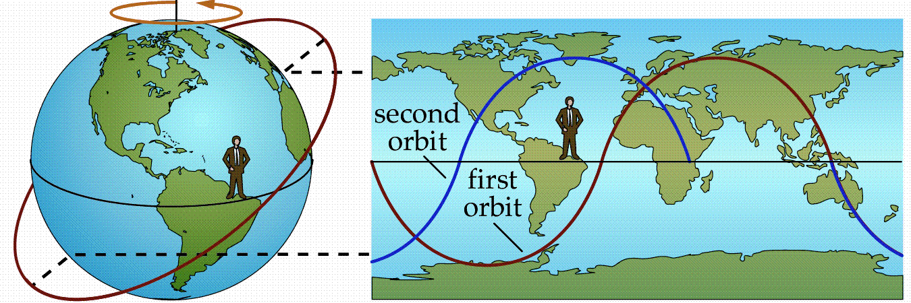
Classifying orbits - Inclination
Inclination effects what parts of the earth are visible.
Non-Rotating Earth
Rotating Earth

Slide 39
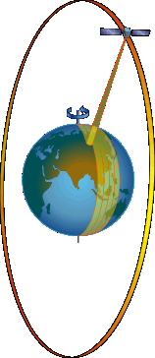
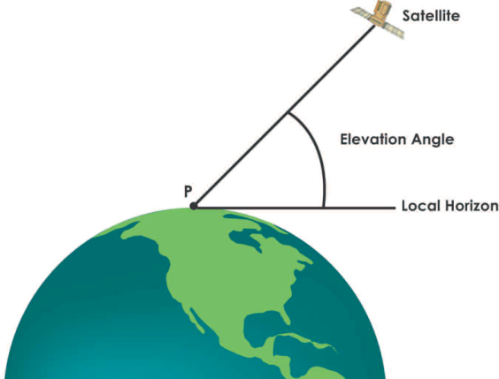
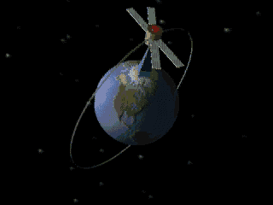
90 degree Inclination -Polar Orbits
These orbits have an inclination near 90 degrees.
This allows the satellite to see virtually every part of the Earth as the Earth rotates underneath it.
It takes approximately 90 minutes for the satellite to complete one orbit.
90 deg

Slide 40
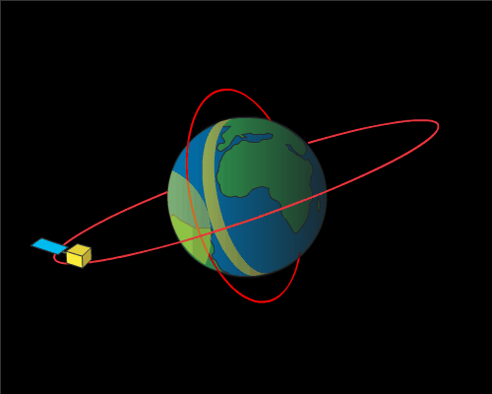
90 degree Inclination -Polar Orbits
Useful for mapping and remote sensing when the whole of the earth’s surface needs to be studied

Slide 41
Classifying orbits - Altitude
Low-Earth orbit (LEO) – an orbit from 200 – 2000 km above the Earth
Very fast orbits to maintain altitude.
Periods in order of 90 minutes
Advantages - Shorter time required for communication signals to go to and from them. Satellite phone systems and some high speed telecommunications use them because of this.
Disadvantages – Communication windows are often short due to velocity.
Orbits are effected by atmospheric drag and thus have shorter life before their orbits decay.

Slide 42
Classifying orbits - Altitude
Medium-Earth orbit (MEO) – one with an altitude from 2000 to 35 790 km
Handle most broadband communications.
Rely on inter satellite links to communicate over distances.
Advantages – longer periods, slower orbits and therefore can match Earth rotation at the highest levels.
Orbits less effected by atmospheric drag.
Communication windows longer and coverage greater.
Disadvantages – Slower for communication
High-Earth orbit ( HEO)– an orbit at an altitude higher than 35 790 km
Because of their radius, the periods of such orbits are greater than twenty-four hours,
therefore satellites in such orbits have an apparent retrograde motion – that is, they appear to move backwards across the sky compared to other satellites. Global coverage.

Slide 43
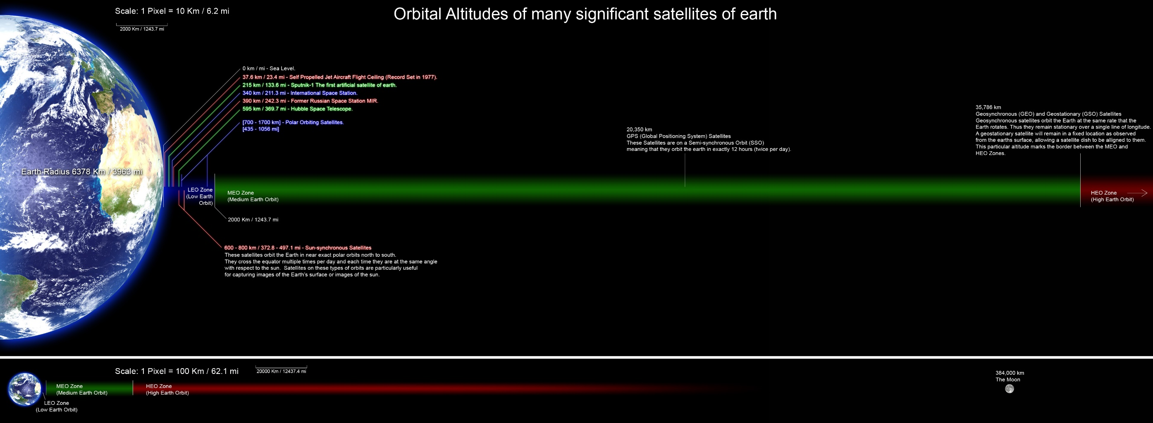
Classifying orbits - Altitude

Slide 44

Classifying orbits - Altitude

Slide 45

Classifying orbits - Altitude

Slide 46
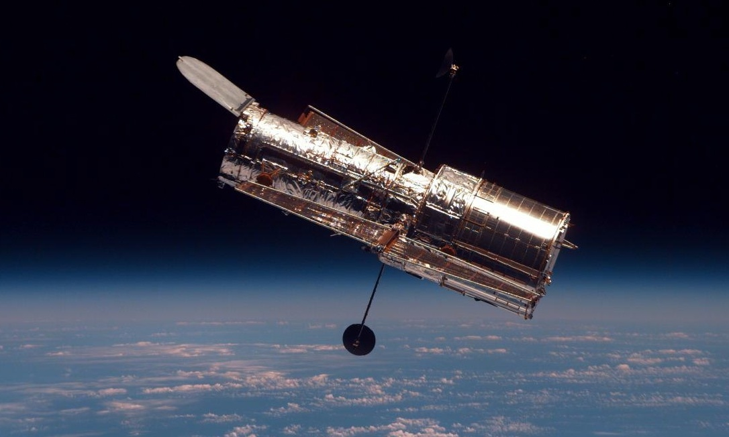
Hubble Space telescope

Slide 47
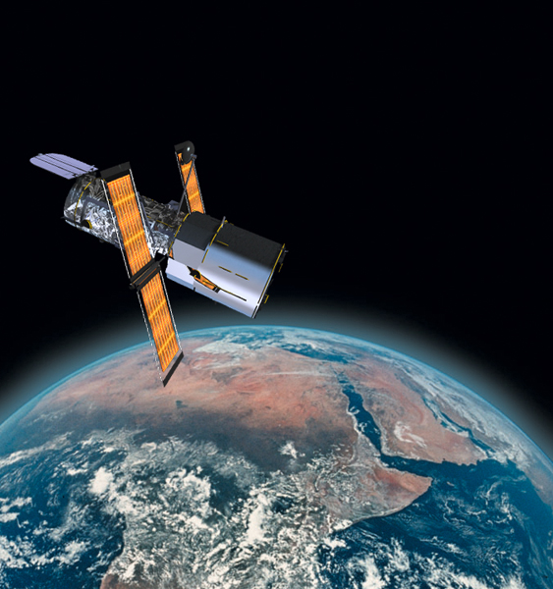
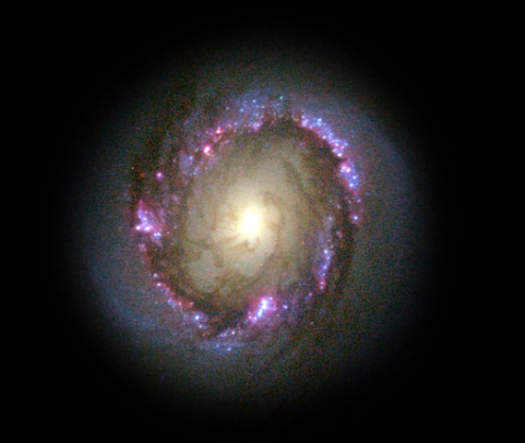
Hubble Telescope
Classification: LEO
Orbit: 600 km.
Revolution time: 100 min.
Speed: 27,000 km/hr
Concerns: Orbit decay from gravity and solar output. During “solar maximum”, the densities at all altitudes are enhanced, and the drag effects on satellites are much larger than during times of solar minimum.

Slide 48
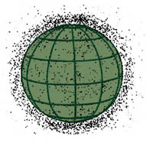
Space Debris
According to the U.S. Space Command (USSC), there are more than 8,000 objects larger than a softball now circling the globe.
Of these, over 2000 are satellites (working and not).

Slide 49
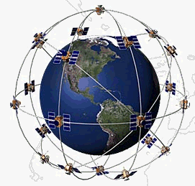
GPS: What is it ? (MEO)
A constellation of 24 satellites
The Global Positioning System (GPS) is a worldwide radio-navigation system formed from a constellation of 24 satellites and their ground stations.
They are constantly moving, making two complete orbits in less than 24 hours.
These satellites are traveling at speeds of roughly 11 200 km an hour.
GPS Satellites
Name: NAVSTAR
Manufacturer: Rockwell International
Altitude: 20 000 km
Weight: 862 kg (in orbit)
Size: 6m with solar panels extended
Orbital Period: 12 hours
Orbital Plane: 55 degrees to equatorial plane
Planned Lifespan: 7.5 years
The spacing of the satellites are arranged so that a minimum of five satellites are in view from every point on the globe.

Slide 50
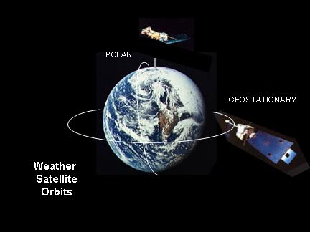
Geosynchronous-Earth-Orbit (MEO)
Orbit is synchronous with the earths rotation.
i.e Period of 24hrs.
A geostationary orbit is a geosynchronous orbit that is above the equator and orbiting in the same direction as the Earth’s rotation.

Slide 51
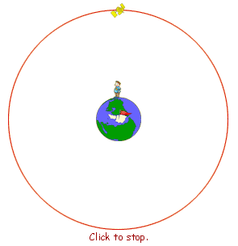
Geostationary (MEO)
The satellite orbits once every 24 hours, so appears to stay above the same point on the earth’s surface
Looking from above the North pole

Slide 52
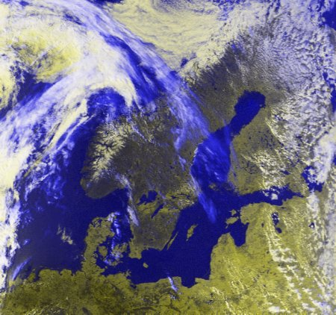
Geostationary (MEO)
Useful for communications satellites. Also for weather over one area.
Because geostationary satellites circle the earth at the equator, they are not able to provide coverage at the Northernmost and Southernmost latitudes

Slide 53
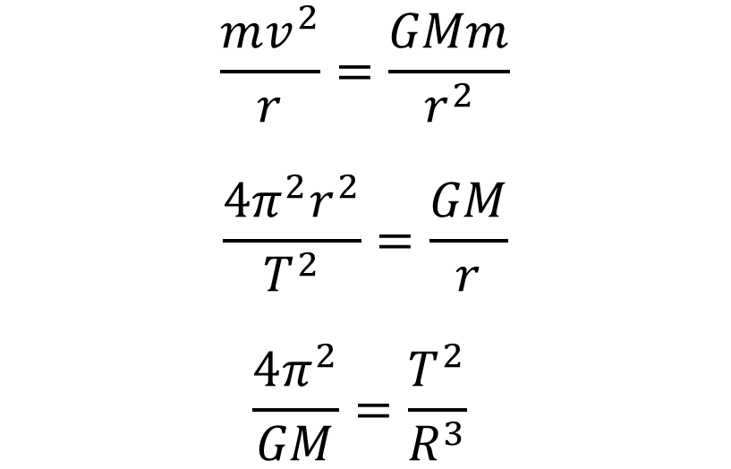
Geostationary (MEO)
Geostationary satellites
At a certain height, the period of orbit will be 24hrs. This is a geostationary satellite; it will always appear over the same place.
Centripetal force
Gravitational force
$$\frac{mv^{2}}{r}=\frac{GMm}{r^{2}}$$
$$\frac{4π^{2}r^{2}}{T^{2}}=\frac{GM}{r}$$
$$\frac{4π^{2}}{GM}=\frac{T^{2}}{R^{3}}$$
If the orbits are all around the Earth, then this is a CONSTANT VALUE
If geostationary period is 24Hrs, what does this tell us about the Radius?
Geostationary satellites must orbit the equator.

Slide 54
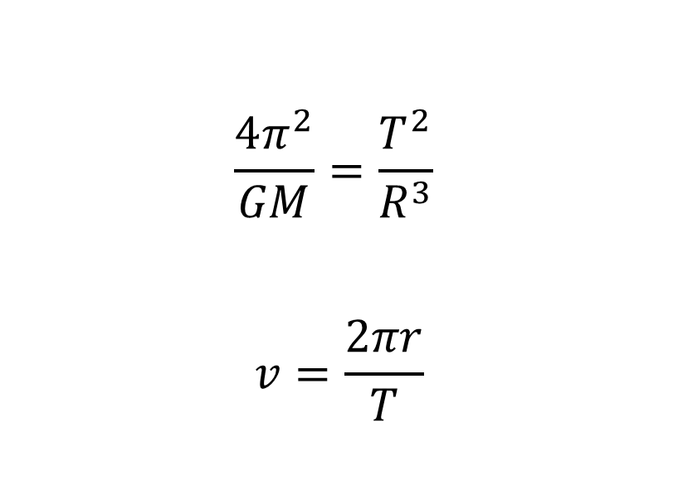
Geostationary (MEO)
Geostationary satellites
$$\frac{4π^{2}}{GM}=\frac{T^{2}}{R^{3}}$$
$$v=\frac{2πr}{T}$$
If Period and Radius are also both a set value for Geostationary Orbits, then what does this mean about velocity?
Velocity must be a CONSTANT VALUE as well!
That means that for an orbit to be geostationary, there is:
An orbit above the Equator in the same direction as Earth rotation
A Period of exactly 24hrs
A Set Radius
A Set Velocity

Slide 55
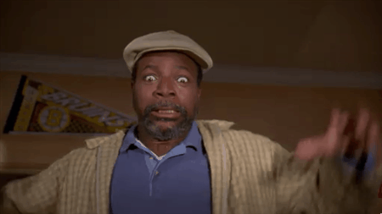
Geostationary (MEO)
Geostationary satellites
Now YOU work out what the required
radius and velocities are:

Slide 56
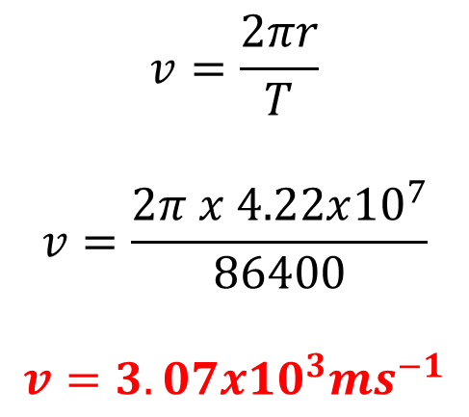
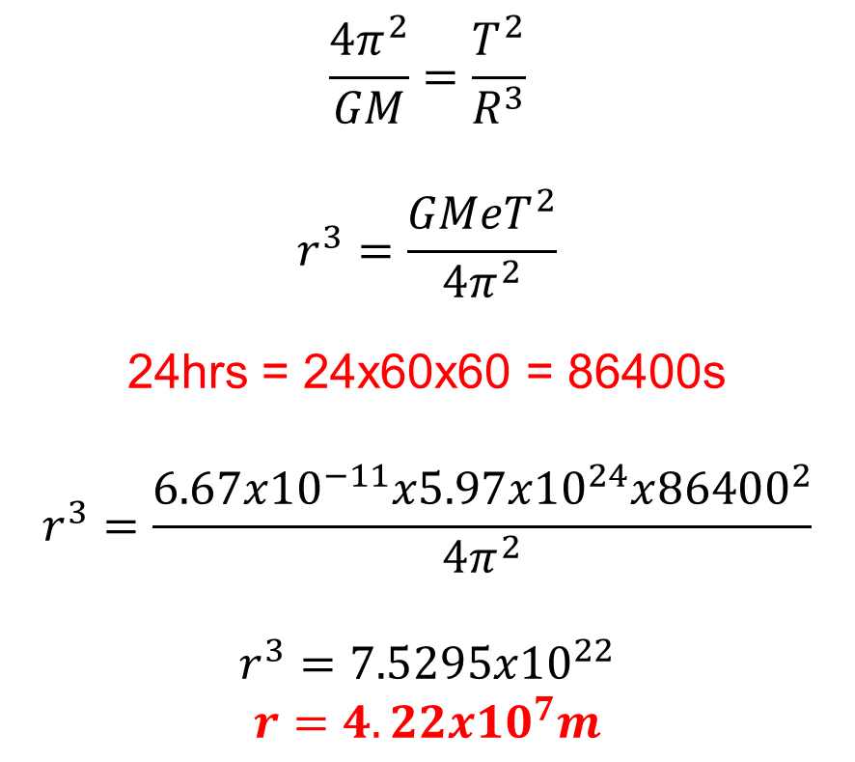
Geostationary (MEO)
Geostationary satellites
$$\frac{4π^{2}}{GM}=\frac{T^{2}}{R^{3}}$$
$$r^{3}=\frac{GMeT^{2}}{4π^{2}}$$
24hrs = 24x60x60 = 86400s
$$r^{3}=\frac{6.67x{10}^{−11}x5.97x{10}^{24}x{86400}^{2}}{4π^{2}}$$
$$r^{3}=7.5295x{10}^{22}$$
$$r=4.22x{10}^{7}m$$
$$v=\frac{2πr}{T}$$
$$v=\frac{2π x 4.22x{10}^{7}}{86400}$$
$$v=3.07x{10}^{3}ms^{−1}$$

Slide 57
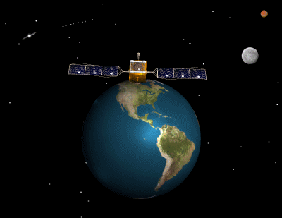
Some famous satellites

Slide 58
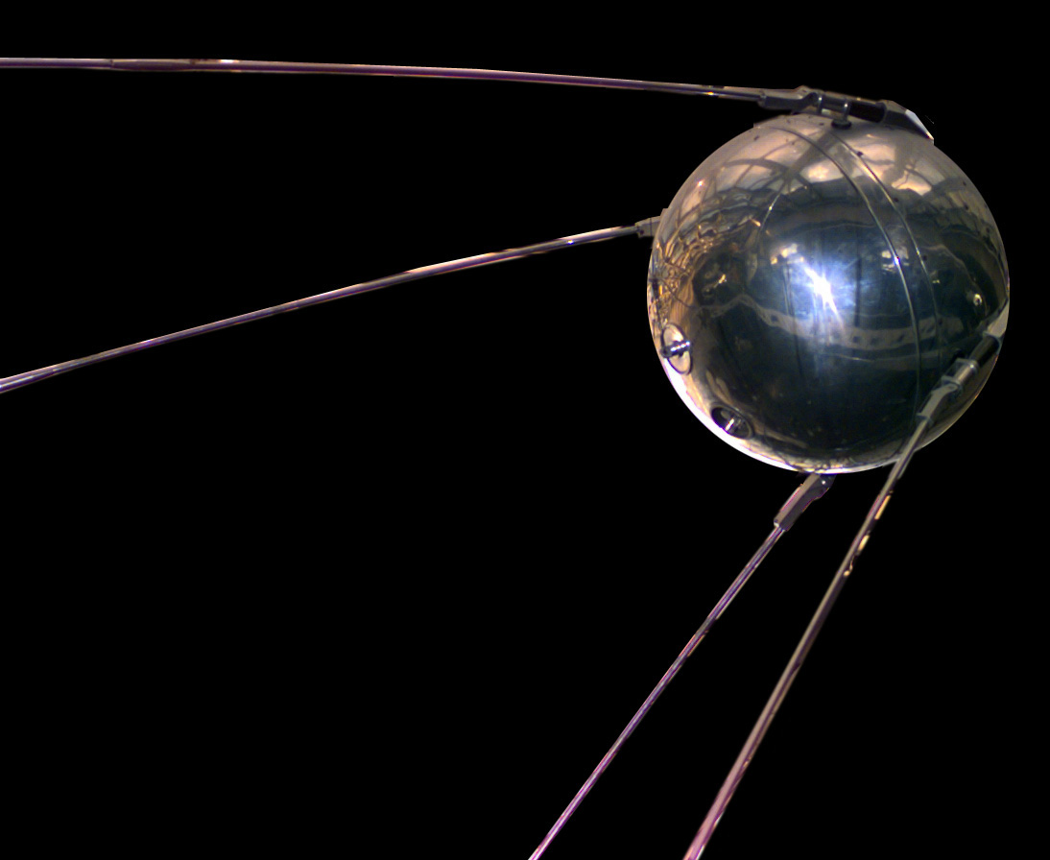
Sputnik (4th October 1957)

Slide 59

Sputnik (4th October 1957)
Russian
84 kg, 58cm diameter
800km above the earth
30 000km/h
Orbited every 90 mins
Fell after 92 days

Slide 60
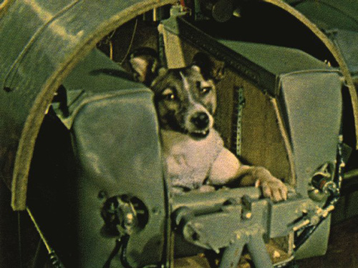
Sputnik 2 (a month later)

Slide 61
Sputnik 2 (a month later)
450 kg
Carried a dog! (Laika)
Laika is believed to have died from overheating in the cabin a few hours after launch
Your teacher isn’t the only one who launches dogs into space.

Slide 62

Hubble Space telescope
Launched in 1990
13.1m long
Gets better images than bigger telescopes on the Earth because it doesn’t have to deal with atmospheric distortion.

Slide 63

Now go do some text questions!
Arrrgghhh!

